Slide 1
Opioid Prescription Predictor
Jimmy Smart

Slide 2
Project Outline
Q: Can opioid prescriptions be predicted by features such as location by states or gender of prescribing specialists?
Introduction
Data Wrangling
Dropping redundant variables
Identify opioid drug names
Data Visualization
States
Specialty
Gender
Drugs
Summary
Statistical Analysis
Frequentism
Bootstrapping
Bayesian Inference
Model Optimization
OLS
Random Forest
XGBoost
Comparing models
Conclusion

Slide 3
Introduction
Dataset contains summaries of prescription records for 250 common opioid and non-opioid drugs written by nearly 25,000 unique licensed medical professionals in 2014 located in the United States
This is only a small subset of data that was sourced from a much larger file: cms.gov.
The original datasets called opioid.csv, overdoses.csv and prescriber-info.csv were loaded in as 3 datasets into a Jupyter Notebook.
The goal of this project is to use the features listed above to predict whether an opioid prescription is based of certain specialists and is influenced by their location and/or gender

Slide 4
Data
Wrangling

Slide 5
Redundant variables from prescriber dataset
An initial glance at the dataset revealed certain variables to be redundant and some containing missing values or contain many unique categories, all of which would provide little information during further analysis or during the modeling process:
Removed:
Credentials: deemed redundant due to the more important Specialty variable
Within the State variable we removed US territories: PR, AA, GU, AE, ZZ as we just want to focus on the 50 states.
DC was merged into VA

Slide 6
Identifying opioid drug names
List of opioids:
MORPHINE.SULFATE.ER
METHADONE.HCL
HYDROCODONE.ACETAMINOPHEN
ACETAMINOPHEN.CODEINE
HYDROMORPHONE.HCL
MORPHINE.SULFATE
TRAMADOL.HCL
FENTANYL
OXYCODONE.HCL
OXYCODONE.ACETAMINOPHEN
OXYCONTIN

Slide 7
Data
Visualization

Slide 8
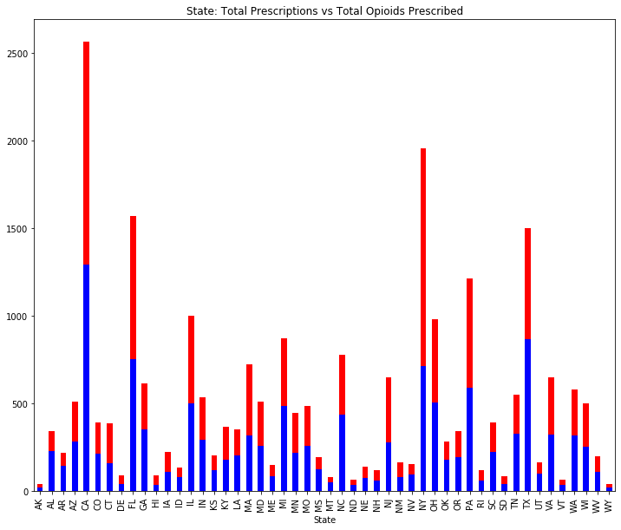
Looking at the data with a focus on the States
Total Prescriptions given out by our Specialists
Total Opioids prescribed by our Specialists

Slide 9
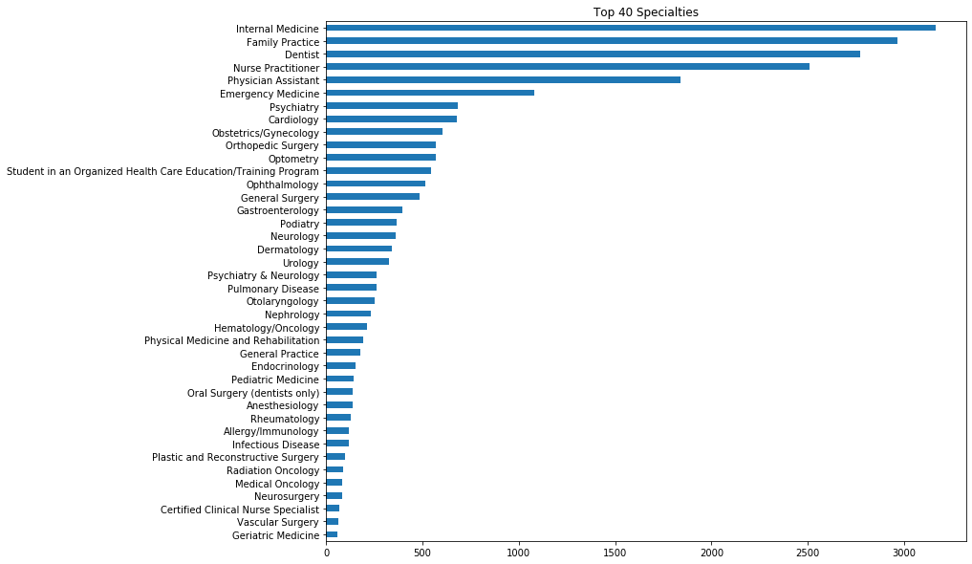
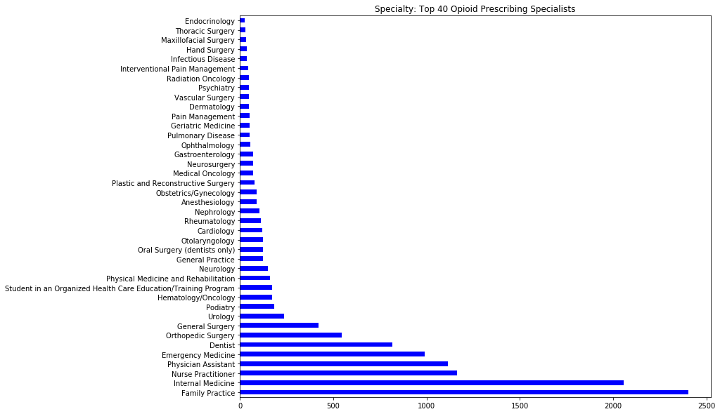
Top 40 value count specialists
Top 40 Opioid Prescribing specialists

Slide 10
Specialties
We created a chart for the top 5 specialists who prescribed opioids and their percentages in reference to the rest of the specialties:
Percentage of Prescriptions from the top 5 prescribers
Value Opi % Opi
Family Practice 2402 18.93
Internal Medicine 2057 16.21
Nurse Practitioner 1165 9.18
Physician Assistant 1113 8.77
Emergency Medicine 990 7.80

Slide 11
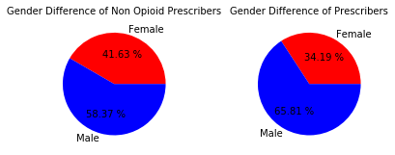
Overall there were 5025 Females who didn’t prescribe opioids and 7046 Males who also didn’t prescribe opioids.

Slide 12
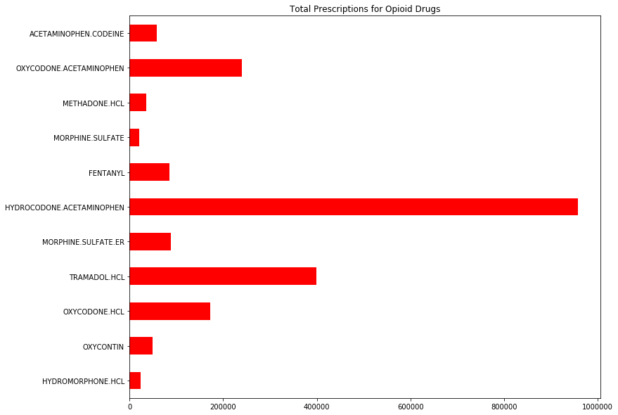
Drugs
Value counts of opioid drugs

Slide 13
Data Visualization Summary
We can see a trend in which specialists seem to be prescribing the most drugs in general, as well as which ones seem to be prescribing the most opioid related drugs.
Considering that most opioid drugs are based on pain relief, it’s not surprising to see that certain specialists who deal in medical fields that interact with patients coming to them looking for some sort of pain relief, seem to be the common opioid prescribers..

Slide 14
Statistical
Analysis

Slide 15
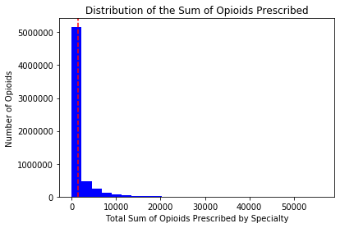
Frequentism
We have a probability value (p-value) of (0.999) meaning likelihood or probability that the difference we see in sample means is due to chance.
We achieved a good critical value of (1.959/95%) in context of the population distribution and a probability.

Slide 16
Bootstrapping
We'll create a bootstrap sampling to estimate a 95% confidence interval lower limit.
Null Hypothesis: There isn't a difference in the standard deviation between the 2 groups (specialists prescribing opioids and specialists who didn't prescribe opioids)
Alternate Hypothesis: There will be a differ in the standard deviation between the 2 groups (specialists prescribing opioids and specialists who didn't prescribe opioids)
Difference of STD for opioid and non opioid prescriptions: 3003.248
Difference of STD for bootstrap samples: 3003.302123387791
The 95% confidence interval for the difference between the standard deviations of opioid and non opioid prescriptions is: [2826.54281741 3187.76267874]

Slide 17
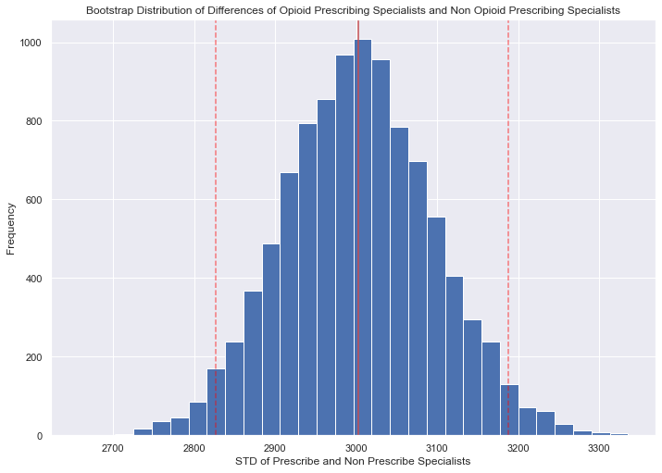
Shows our the Bootstrap replicate with a confidence interval of (2826.542 and 3187.763)
With the p-value from the bootstrap being 0.6619, I can reject the alternate hypothesis and accept the null hypothesis

Slide 18
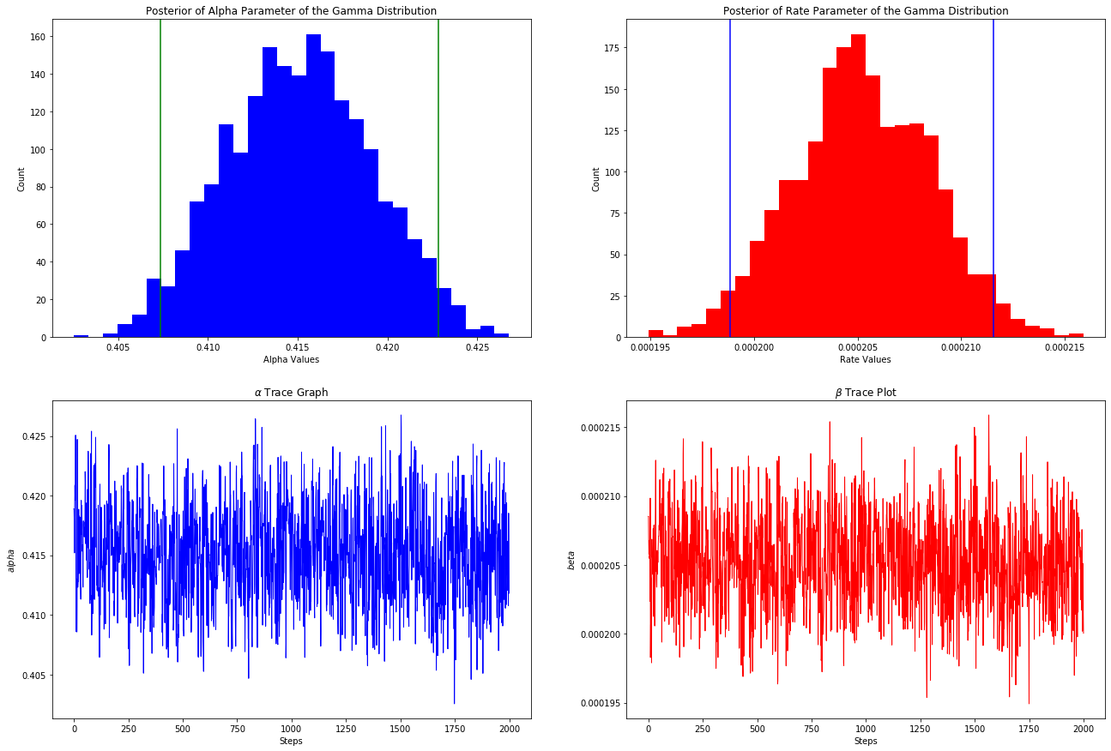
Bayesian Inference - Creating a PyMC3 Model - Credible Intervals
Our histograms show non-normal distribution
The path meander in certain directions which implies autocorrelation

Slide 19
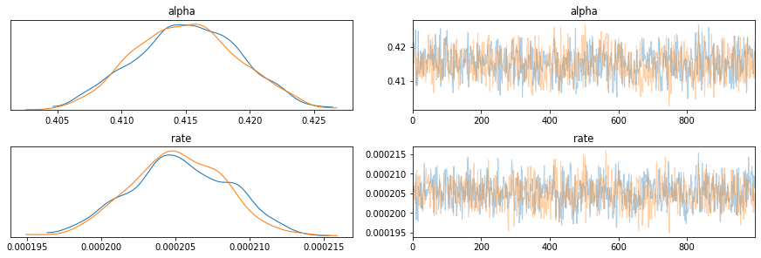
Credible Intervals
Alpha_chi = [0.40736891 0.42284083] Rate_ci = [0.00019885 0.00021156]

Slide 20
Model
Optimization

Slide 21
OLS - Ordinary Least Squares
Dep. Variable: | Opioid_Prescriber | R-squared: | 0.338
Model: | OLS | Adj. R-squared: | 0.334
Method: | Least Squares | F-statistic: | 79.92
Date: | Mon, 04 May 2020 | Prob (F-statistic): | 0.00
Time: | 10:00:16 | Log-Likelihood: | -12485.
No. Observations: | 24759 | AIC: | 2.529e+04
Df Residuals: | 24601 | BIC: | 2.657e+04
Df Model: | 157
Covariance Type: | nonrobust
coef | std err | t | P>|t| | [0.025 | 0.975]
Intercept | 0.5862 | 0.241 | 2.432 | 0.015 | 0.114 | 1.059
Opioid_Prescriber as our dependent variable and added Gender, State and Speciality variables to enhance our model.

Slide 22
Random Forest Regression: Importance Feature
 | Feature | importance | rank
74 | Specialty_Family Practice | 0.106276 | 1
0 | Population | 0.070633 | 2
71 | Specialty_Emergency Medicine | 0.066525 | 3
91 | Specialty_Internal Medicine | 0.063420 | 4
119 | Specialty_Orthopedic Surgery | 0.048439 | 5
Our Random Forest model produced a higher accuracy a score: 0.7427551
We can see that Family Practice, Emergency Medicine, Internal Medicine and Orthopedic Surgery specialists came in at the the highest importance. Population is also a factor.

Slide 23
Baseline Test (default parameters)
Model | Class | Precision | Recall | F1-score | Support | Accuracy
Random Forest Classifier | 0 (less than 10 prescriptions) | 0.68 | 0.70 | 0.69 | 3084 | 0.74
 | 1 (10 or more opioid prescriptions) | 0.79 | 0.77 | 0.78 | 4344
macro avg 0.73 0.74 0.74 7428
Created our model based on our best performing variables
Our best performing model with a good accuracy rate
Values (Precision, Recall and F1-Score) could be higher (1) but still good

Slide 24
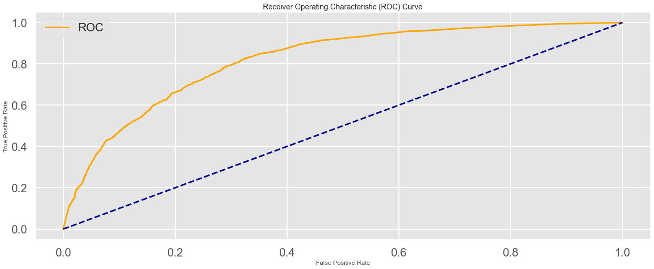
ROC-AUC curve = performance of model. True Positive and False Positive rates
ROC AUC = 0.809

Slide 25
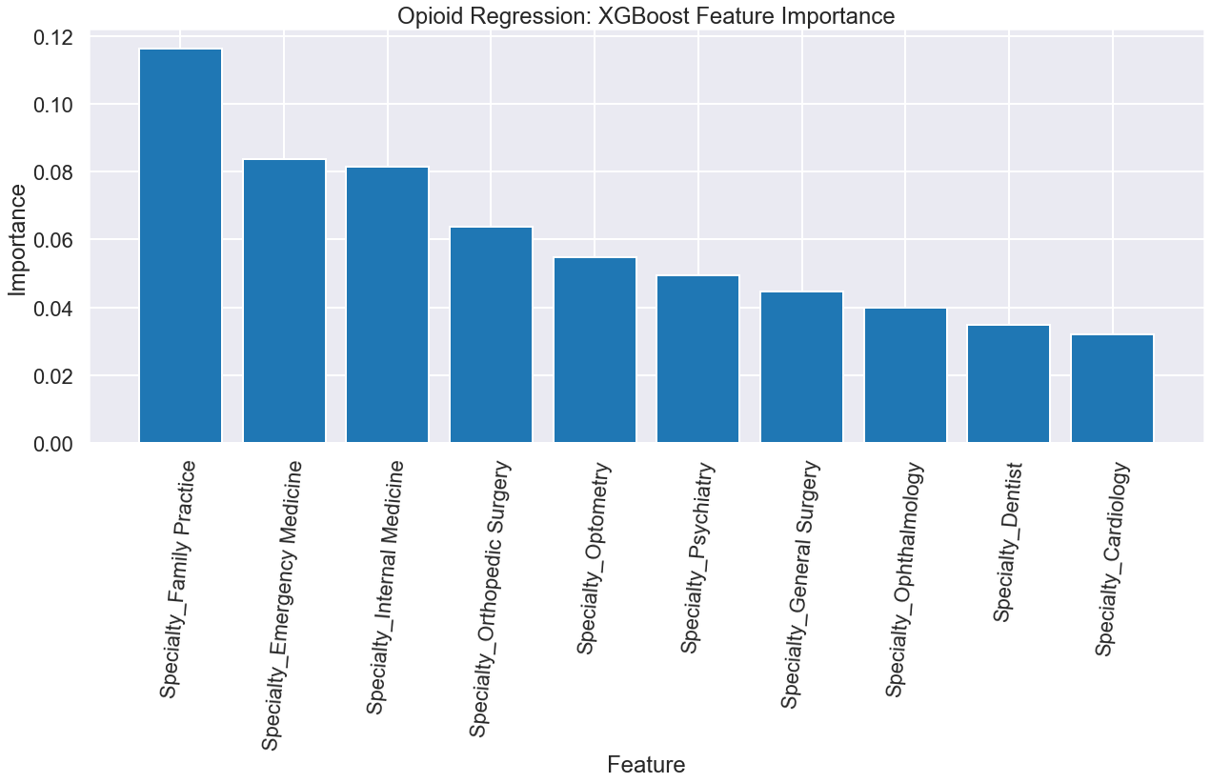
XGBoost Feature Importance

Slide 26
Comparing Models
Our models weren’t especially impressive but offered valuable information.
Adding more variables to our OLS model only caused our r-squares results to raise slightly.
Random Forest and XGBoost offered our highest accuracy along with insightful information in forms of providing us an insight of which specialists had a higher chance of prescribing opioid prescriptions.
Name | r-squared
OLS Regression | 0.337779
Random Forest | 0.272954
XGBoost | 0.247265
Lasso | 0.339964

Slide 27
Conclusion
Results
Results:
Our models did not score as high as we would have liked but we were able to see some benefits from them
Certain types of specialists and locations did show that they were factors when predicting opioids prescriptions.
More tuning and reworking with the categorical variables will be needed to better tune the models.
Next Steps:
Further modeling and hyperparameter tuning can be done.
Additional data would be needed to better improve the model

